Slide 1
A Causal Inference Approach to Predict Sepsis in Patients Using Q-Learning
A Background Presentation by: Noah Dunn

Slide 2
I don’t understand what any of those words mean.

Slide 3
Neither did I
Steven Yu and I started working on the precursor to this project at the end of last Summer alongside Dr. Gani
I have pieced together some of the material that we left off on, and I intend to pick up where we left off our my exploration

Slide 4
The Three Central Ideas Here
Understand What Sepsis Is
Understand What Q-Learning Is
Understand What Causal Inference Is

Slide 5
Remember, this just Background
If I manage to get you familiar with what my topic means by the end, I will feel successful.
I will have designated slides throughout to stop for any questions

Slide 6
Sepsis
The medical condition that started this entire research exploration.

Slide 7
Defining Sepsis
This was, and still is argued over today
A massive conference of physicians met to hash this out and dubbed themselves “Sepsis-3” (Because it was the third time this had been done in history)
The Sepsis-3 definition, which is widely used for computing purposes, is as follows:

Slide 8
Life-threatening organ dysfunction caused by a dysregulated host response to infection.

Slide 9
In Layman’s Terms
Sepsis is the body’s EXTREME response to an ordinary infection that is already plaguing the body
An infection somewhere already in a person’s body triggers a chain reaction throughout the body.

Slide 10

48.9 Million Cases
11.0 Million Deaths
Ranked in Top 10 Cases of Death Worldwide
Reported in 2017
Reported in 2017

Slide 11
Risk Groups
Current/Former HIV/AIDS or Cancer Patients
Young Babies
The Elderly
People who have recently suffered a major injury
People with diabetes

Slide 12
Sepsis is Hard to Diagnose
The signs and symptoms leading up to a diagnosis are ambiguous
The various small organisms that cause disease to their hosts (pathogens) often reflect different symptoms
Sepsis affects the ability of a person to think coherently. A patient often doesn’t know what’s going on to the point of being deranged

Slide 13
How do physicians diagnose Sepsis if it is so hard to do?

Slide 14
Two Modern Approaches
SOFA Score
Developed in 1994
6 Different Tests (One for each organ system)
Scale is 0-4 for each test
The slower and more thorough approach
quickSOFA (qSOFA) Score
Developed in 2016
1 Single Test
Scale is 0-3
The quicker and simpler approach

Slide 15
Speed is the Key
Treatment within 6 hours of Sepsis recognition is ideal
Each hour of delay between suspected diagnosis and treatment decreases survival rate by 7.6%
Only 50% of patients with Septic Shock (the most deadly form of Sepsis) receive therapy treatment within 6 hours.

Slide 16
Any Questions?
Sepsis
Risk
SOFA vs pSOFA
Need for Speed

Slide 17

Q-Learning
Machine Learning for those who never look back.

Slide 18
Let’s Avoid Getting Ahead Of Ourselves
Q-Learning is a form of Machine Learning
Without understanding the basics of Machine Learning, Q-Learning will make little sense
So, what is Machine Learning?

Slide 19
The ability to make computers modify or adapt their actions so that their actions get more accurate. Accuracy is defined as more correct answers than incorrect answers.

Slide 20
There are Four Types of ML Algorithms
Supervised
Provided data with only correct answers
Builds a model that will give all correct correct answers to the initial data
Unsupervised
Provided data with no answers
Builds a model based upon similarities in input data
Evolutionary
Determines a metric for “fitness” of models (how good they are)
Adapts to models with higher fitness

Slide 21
Q-Learning Falls Under the 4th Category
Reinforcement
Provided information when the model comes up with the incorrect response, but not why the response is incorrect.
The Model tries multiple approaches until it gets the approach correct

Slide 22
Okay, but what does it actually do?
The Q-Learning algorithm optimizes individual qualities (that’s what the Q stands for) of the model.
A quality can be as simple as a factor in a model (like a patient’s blood type) and the optimization is how much the model believes that factor impacts the outcome
Recall: Our final output will be a model that we want to make more good decisions than bad ones.

Slide 23
No Turning Back
Q-Learning is Off-Policy, once it makes a decision it never goes back to consult previous decisions.
It will Iterate as many times as it needs until it is done
We can use Q-Learning to provide “best” solutions to several kinds of models, including Markov Decision Processes (MDPs)

Slide 24
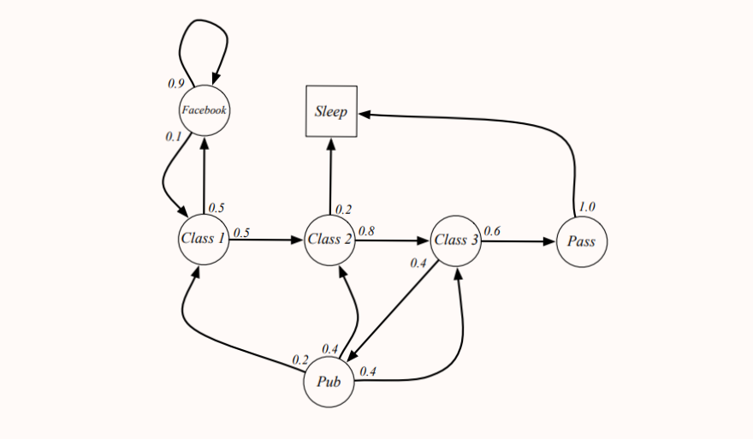
Example: A Markov Decision Process
4. A description of each action’s effects in each state (a decimal in this case)
1. A set of possible world states
3. A real valued reward function (not shown)
2. A set of possible actions

Slide 25
Why Use MDPs?
They provide a way to model complex decisions
All decisions must be independent of decisions made in the past (sound familiar?)
The “real valued reward function” can be generated by Q-Learning’s output
They can be optimized by our final topic

Slide 26
Okay, I might be starting to understand this. But how does Q-Learning get us to that final model?

Slide 27
The Q-Learning Function
Qt+1 (st, at) = Qt (st, at) + α (rt+1 + γ max a Qt (st+1, a) − Qt (st, at))

Slide 28
NOPE

Slide 29
Next Q-Value
Q-Value of best possible action given the current state
Qt+1 (st, at) = Qt (st, at) + α (rt+1 + γ max a Qt (st+1, a) − Qt (st, at))
Current Q-Value

Slide 30
That function will produce the Q-Equation
Given any state, the Q-Equation will produce the best action at that state
For in example, in Sepsis diagnosis. If we are at a state where a patient is demonstrating higher blood pressure, lower brain activity, and a high respiratory rate(qSOFA), the model may determine the best action as Sepsis diagnosis

Slide 31
Any Questions?
Q-Learning
Markov Decision Processes
Our Goal
Q-Learning Function
Q-Equation

Slide 32
Causal Inference
Why?

Slide 33
Statistical Inference
Main method of determining significant differences between data
Builds models with predictors (factors) that when given values produce an outcome
For Sepsis, we want a model that can diagnose when provided a patient’s vitals
Does not explain why predictors are related

Slide 34
Causal Inference: A New Approach
Prof. Judea Pearl received a Turing award for his work on this topic in 2012
Goal is to represent causal claims in a field that does not often consider them
Allows the creation of Structural Causal Models

Slide 35

A person’s wealth
How much a person goes out to eat

Slide 37
There is a strong, positive correlation between a person’s wealth and how much they go out to eat.

Slide 39
Is This Necessarily Wrong?
No. Not at all.
However, we can do better.

Slide 40
A person’s age

Slide 42

Baby’s First SCM
Causes
Causes

Slide 43
Baby’s First SCM
Causes
Causes

Slide 44
Defining the Environment
The statistician decides what is exogenous to the model (outside the scope) or endogenous to the model(inside the scope)
They then find as many causal relationships as possible

Slide 45
Available Structures in SCMs
Chains
Forks
Colliders
We can combine these as desired

Slide 46
An Example Chain

Slide 47
An Example Fork

Slide 48
An Example Collider

Slide 49
Intervention
At any point in the diagram. We can fix a constant value. This is called an “intervention”
This value may be arbitrarily chosen for testing, or more likely obtained from some other study.

Slide 50
Intervention
0.26

Slide 51
What’s the point?
We see what is really happening better
We have a scientific approach to making causal claims
Our models show the relationships at a certain scope

Slide 52
More Practically
SCM techniques can be used to build better MDP
Better MDP models result in better Q-Learning Solutions
Better Q-Learning solutions yield more accurate diagnoses.

Slide 53
Any Questions?
Causal Inference
Structural Causal Models (SCM)
Forks, Chains, Colliders
Intervention
The Benefits

Slide 54
Recap Roadmap
We discussed Sepsis, why it is hard to diagnose, and why it is a major problem
We discussed SCMs, and how to improve our MDPs using their techniques
Sepsis
Causal Inference
Q-Learning
We discussed MDPs and how we can solve them with Q-Learning

Slide 55
Giving Credit Where Credit is Due
This entire presentation’s theme was provided by SlidesCarnival under the Creative Common’s License.
Also several of these slides follow stylistic guidelines and examples provided by SlidesCarnival
Icons provided by FontAwesome also under CC

Slide 56
Thank You!

